Slide 1
Discrete Mathematics (CSC 1204)
Chapter 1
1.1 Propositional Logic

Slide 2
Key Terms
Logic: Logic is the discipline that deals with the methods of reasoning.
Logic is the basis of all mathematical reasoning
The rules of logic specify the meaning of mathematical statements
Propositional Logic: The area of logic that deals with propositions is called the propositional logic.

Slide 3
Key Terms
Proposition: A proposition is a declarative statement that’s either TRUE or FALSE, but not both.
Statements that are not propositions include
questions
commands

Slide 4
Key Terms
Propositional variable: A variable that represents a proposition. The conventional letters used for propositional variables are p, q, r, s, t,..
Compound proposition: A proposition constructed by combining two or more propositions using logical operators (AKA : logical connectives)
Logical Operators: Operators used to combine propositions
Truth Value: The truth value of a proposition is true, denoted by T, if it is a true statement and false, denoted by F, if it is a false statement. Truth Value ==> Either True or False
Truth Table: A table displaying the truth values of propositions.

Slide 5
Proposition: Examples
Proposition | Not Proposition
3 + 2 = 32 | Bring me coffee!
3 + 2 = 5 | 3 + 2
CSC 1204 is Katrina’s favorite class | CSC 1204 is her favorite class
Every cow has four legs | Do you like Cake?

Slide 6
Proposition: More Examples
Which of the following are propositions? What are the truth values of those that are propositions?
a. Read this carefully.
b. 2 + 2 = 4.
c. Comilla is the capital of Bangladesh.
d. What time is it?
Solution.
a. Not a proposition (because it’s a command).
b. A proposition with truth value (T).
c. A proposition with truth value (F).
d. Not a proposition (because it’s a question).

Slide 7
Class Work
Which of the following are propositions? What are the truth values of those that are propositions?
5 + 7 = 17
Answer the question
x + 2 = 13
x + y = z
AIUB is the best public university in Bangladesh

Slide 8
Logical Operators
Logical operators ==> unary, binary
Unary:
Negation
Binary
Conjunction
Disjunction
Exclusive OR
Conditional/Implication
Biconditional

Slide 9
Logical Operators: Symbols & Usage
Operator | Symbol | Usage
Negation | ¬ | NOT
Conjunction | ∧ | AND
Disjunction | ∨ | OR
Exclusive or | ⊕ | XOR
Conditional | → | if, then
Biconditional | ↔ | iff

Slide 10
Propositional Logic - Negation
Let p be a proposition. The negation of p, denoted by ¬p (or‾p), is the statement “It is not the case that p.”
The proposition ¬p is read “not p”
The truth value of the negation of p, ¬p, is the opposite of the truth value of p.

Slide 11
Propositional Logic - Negation
Negation just turns a false proposition to true and the opposite for a true proposition.
Example1: P: I am going to town
¬ P: I am not going to town; or,
It is not the case that I am going to town
Example2: p： “23 = 15 +7”
p happens to be false, so ¬ p is true.

Slide 12
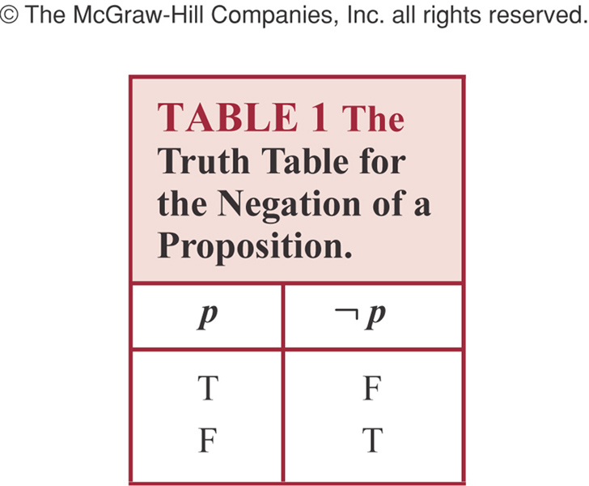
Truth table for Negation of a Proposition

Slide 13
Negation: Another Example
Example: Find the negation of the proposition
“Today is Friday.”
Solution: The negation is
“It is not the case that today is Friday”, or
“Today is not Friday” , or
“It is not Friday today.”

Slide 14
Conjunction
Let p and q be propositions. The conjunction of p and q, denoted by p ∧ q, is the proposition “p and q.”
The conjunction p ∧ q is true when both p and q are true and is false otherwise.
Conjunction corresponds to English “AND”.
Example: Liana is curious AND clever.

Slide 15
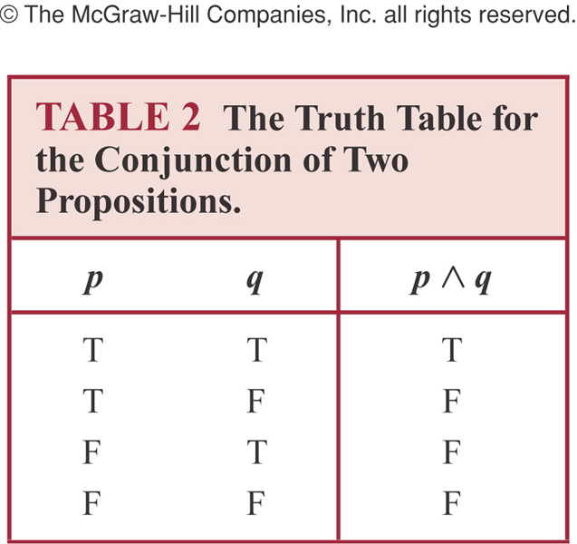
Truth Table for Conjunction

Slide 16
Conjunction: Example
Example: p: ‘I am going to town’
q: ‘It is going to rain’
p ∧ q: ‘I am going to town and it is going to rain.’
Note: Both p and q must be true to p ∧ q be true

Slide 17
Conjunction: Another Example
p = “Clinton is now the president of USA.”
q = “Monica is now the president of USA.”
r = “The meaning of is is important.”
Assuming p and r are true, while q false.
Out of p∧q, p∧r, q∧r , only p ∧ r is true.
Question: what is the truth value of p∧q∧r?
Answer: False (because truth value of q is false)

Slide 18
Conjunction
Conjunction is a binary operator in that it operates on two propositions when creating compound proposition.
On the other hand, negation is a unary operator.

Slide 19
Disjunction
Let p and q be propositions.
The disjunction of p and q, denoted by p ∨ q, is the proposition “p or q.”
The disjunction p ∨ q is false when both p and q are false and is true otherwise.
Disjunction is true when at least one of the components is true.
Disjunction corresponds to English “OR”.
Example: Abdullah is brave OR intelligent

Slide 20

Truth Table for Disjunction

Slide 21
Examples of Conjunction & Disjunction
Let,
p : 5 < 9
q : 9 < 7.
Construct the propositions p∧q and p ∨ q.
Solution:
The conjunction of the propositions p and q is the proposition
p∧q : 5 < 9 and 9 < 7
The disjunction of the propositions p and q is the proposition
p ∨ q : 5 < 9 or 9 < 7
Question: What are the truth values of p ∧ q and p ∨ q?

Slide 22
Examples of Conjunction & Disjunction (See Example 5 & 6 @ Page 4 & 5)
Consider the following propositions:
p : It is Friday
q : It is raining.
Construct the propositions p ∧ q and p ∨ q.
Solution:
The conjunction of the propositions p and q is the proposition
p ∧ q : It is Friday and it is raining.
The disjunction of the propositions p and q is the proposition
p ∨ q : It is Friday or It is raining.

Slide 23
Exclusive Or
Let p and q be propositions.
The exclusive or of p and q, denoted by p ⊕ q, is the proposition that is true when exactly one of p and q is true and is false otherwise.

Slide 24
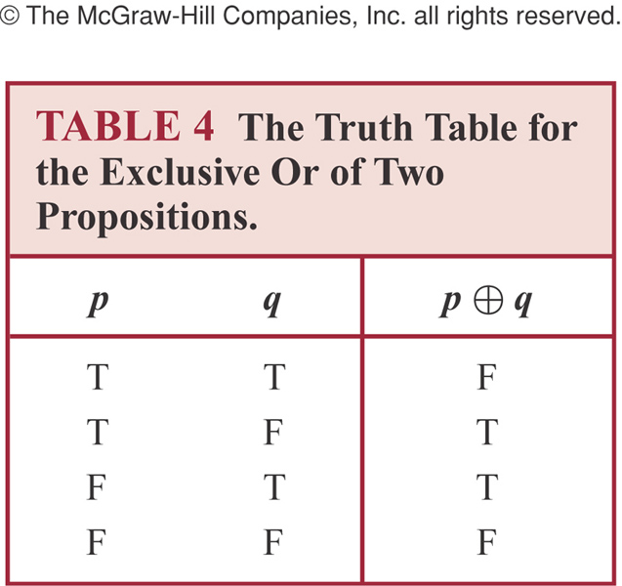
Truth Table of Exclusive Or

Slide 25
Conditional Statements
Let p and q be propositions.
The conditional statement p → q is the proposition “if p, then q.”
The conditional statement p → q is false when p is true and q is false, and true otherwise.
In the conditional statement p → q, p is called hypothesis and q is called conclusion.
This one is the English usage of “if, then” or “implies”.
The connective → is called the ‘conditional connective’.
A conditional statement is also called an implication.

Slide 26
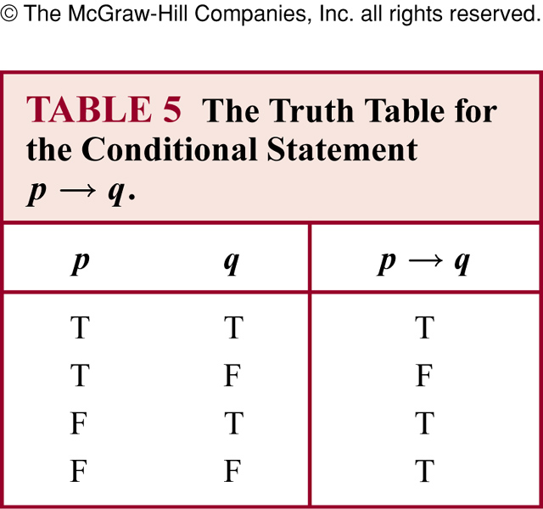
Truth Table for Conditional Statement

Slide 27
Equivalent Expression of p → q
In terms of words, the proposition p → q also reads:
(a) if p, then q, or
if p, q
(The word “then” is sometimes omitted in English sentences)
(b) p implies q
(c) p is a sufficient condition for q , or
a sufficient condition for q is p
(d) q is a necessary condition for p, or
a necessary condition for p is q

Slide 28
Equivalent Expression of p → q
(e) p only if q
(f) q if p , or
q, if p
(g) q whenever p
(h) q when p
(i) q unless ¬p

Slide 29
Remember!
The hypothesis expresses a sufficient condition
The conclusion expresses a necessary condition
“but” is a logical synonym for “and”
“when” / “whenever” means the same as “if”
The hypothesis is the clause following “if”
The conclusion is the clause following “then”
“only if” clause is the conclusion
If hypothesis, then conclusion

Slide 30
Example of Conditional Statement
p = “Cruise ships only go on big rivers.”
q = “Cruise ships go on the Hudson.”
r = “The Hudson is a big river.”
r = “The Hudson is not a big river.”
p ∧ q = “Cruise ships only go on big rivers and go on the Hudson.”
（p ∧ q) → r = “If cruise ships only go on big rivers and go on the Hudson, then the Hudson is a big river.”

Slide 31
Example 7 (page 7)
Let p : "Maria learns discrete mathematics" and q : "Maria will find a good job." Express the statement p → q as a statement in English.
Solution:
"If Maria learns discrete mathematics, then she will find a good job.“
There are many other ways to express this conditional statement in English.
"Maria will find a good job when she learns discrete mathematics”
"For Maria to get a good job, it is sufficient for her to learn discrete mathematics”.
"Maria will find a good job unless she does not learn discrete mathematics.”
For More Examples of this type ➔ Supplementary
Materials will be given soon!

Slide 32
Converse, Contrapositive, and Inverse
We can form some new conditional statements starting with a conditional statement p → q
The Converse of p → q is the proposition q → p
The Contrapositive of p → q is the proposition ¬ q → ¬ p
The Inverse of p → q is the proposition ¬ p → ¬ q

Slide 33
Examples of Converse, Contrapositive and Inverse
Converse: p → q ==> q → p
Example: “If it is noon, then I am hungry.”
Converse: “If I am hungry, then it is noon.”
Contrapositive: p → q ==> ¬q → ¬p
Example: “If it is noon, then I am hungry.”
Contrapositive: “If I am not hungry, then it is not noon.”
Inverse: p → q ==> ¬p → ¬q
Example: “If it is noon, then I am hungry.”
Inverse: “If it is not noon, then I am not hungry.”

Slide 34
Bi-Conditional
Let p and q be propositions.
The biconditional statement p ↔ q is the proposition “p if and only if q.”
The biconditional statement p ↔ q is true when p and q have the same truth values, and is false otherwise.
Biconditional statements are also called “bi-implications”
Question : Which operator is the opposite of ↔?
Answer: ↔ has exactly the opposite truth table as ⊕.

Slide 35
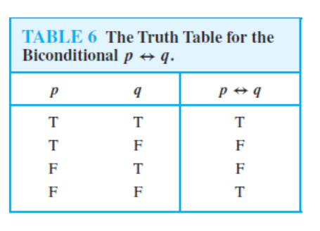
Truth Table for Biconditional p ↔ q

Slide 36
Example of Biconditional statement
Example 10 ( Page 9): Let p be the statement “ You can take the flight” and q be the statement “ You buy a ticket”.
What is the statement for p ↔ q ?
Solution:
“You can take the flight if and only if you buy a ticket”

Slide 37
How to Construct a Truth Table for a Compound Proposition?
At first look at the number of propositions (e.g. p, q, r ) in the given compound proposition.
There will be 2^{n} number of rows in the truth table, where n is the number of propositions in the compound proposition.
Draw the table. In the first row, write down the name of propositions (e.g. p, q, r ) starting from left/first column.
Construct the truth table step by step.

Slide 38
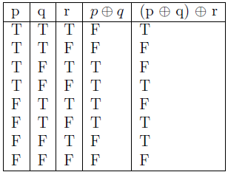
Example: Construct a truth table for (p ⊕ q) ⊕ r
Solution:

Slide 39
How to determine whether two compound propositions are logically equivalent?
Two compound propositions are logically equivalent if they always have the same truth values in the corresponding rows.
Construct a truth table for the given two compound propositions [in one table]
If the truth values of both of the compound propositions are same in the corresponding rows, then they are logically equivalent.
If the true values of both of the compound propositions are different in one or more rows, then they are NOT logically equivalent.

Slide 40

Example
Show that p ↔ q is logically equivalent to (p → q) ∧ (q → p)
Solution:

Slide 41
Truth Tables of Compound Propositions
We can use logical connectives/operators to build up complicated compound propositions involving any number of propositional variables.
We can use truth tables to determine the truth values of these compound propositions.
Example 11 (p. 10): Construct the truth table of the compound proposition (p ∨ ¬q) → (p ∧ q)

Slide 42
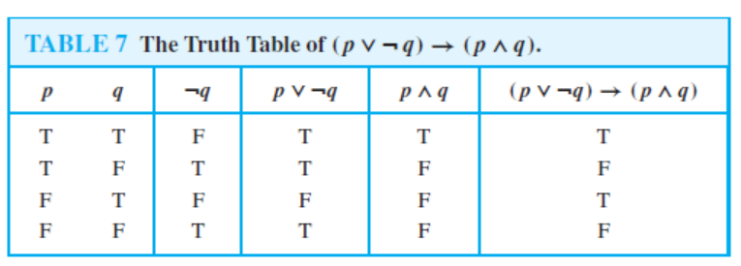
Truth Tables of Compound Propositions

Slide 43
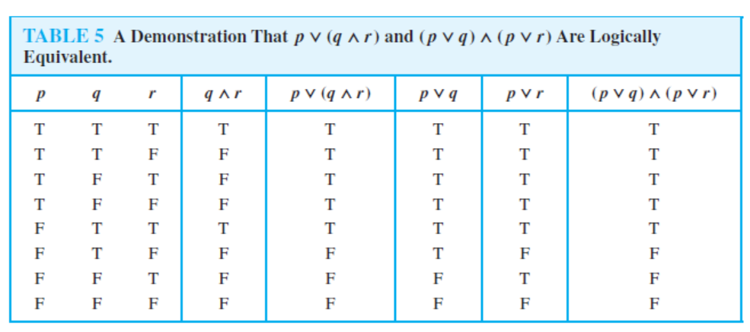
A Demonstration That p ∨ (q ∧ r) and (p ∨ q) ∧ (p ∨ r) are Logically Equivalent

Slide 44
Precedence of Logical Operators
Negation operator is applied before all other logical operators
Conjunction operator takes precedence over disjunction operator
Conditional and biconditional operators have lower precedence
Parentheses are used whenever necessary

Slide 45
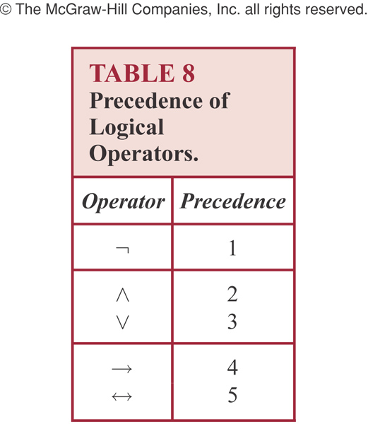
Precedence of Logical Operators

Slide 46
Logic and Bit Operations
bit ==> binary digit
Boolean variable: either true or false
Can be represented by a bit
Bit String: A bit string is a sequence of zero or more bits. The length of the string is the number of bits in the string.
Example 20(p.15): 101010011 is a bit string of length nine

Slide 47
Bit Operations
Computer bit operations correspond to the logical connectives. By replacing true by a one and false by a zero in the truth tables for the operators ∧, ∨, and ⊕, the tables shown in Table 9 for the corresponding bit operations are obtained. We will also use the notation OR, AND, and XOR for the operators ∨,∧, and ⊕ respectively, as is done in various programming languages.

Slide 48
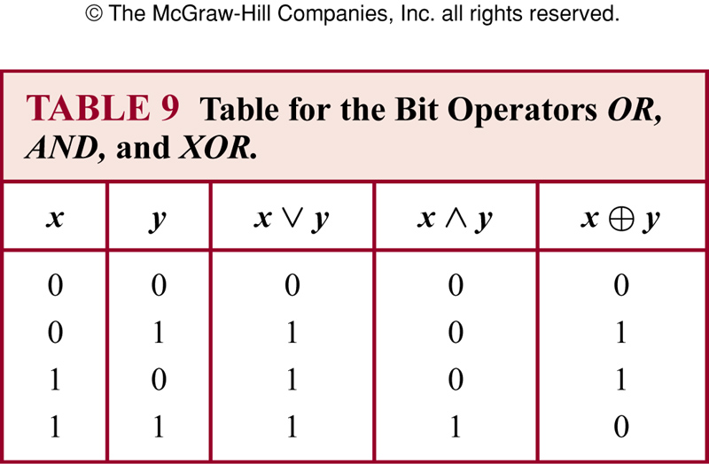
Table for Bit Operations

Slide 49
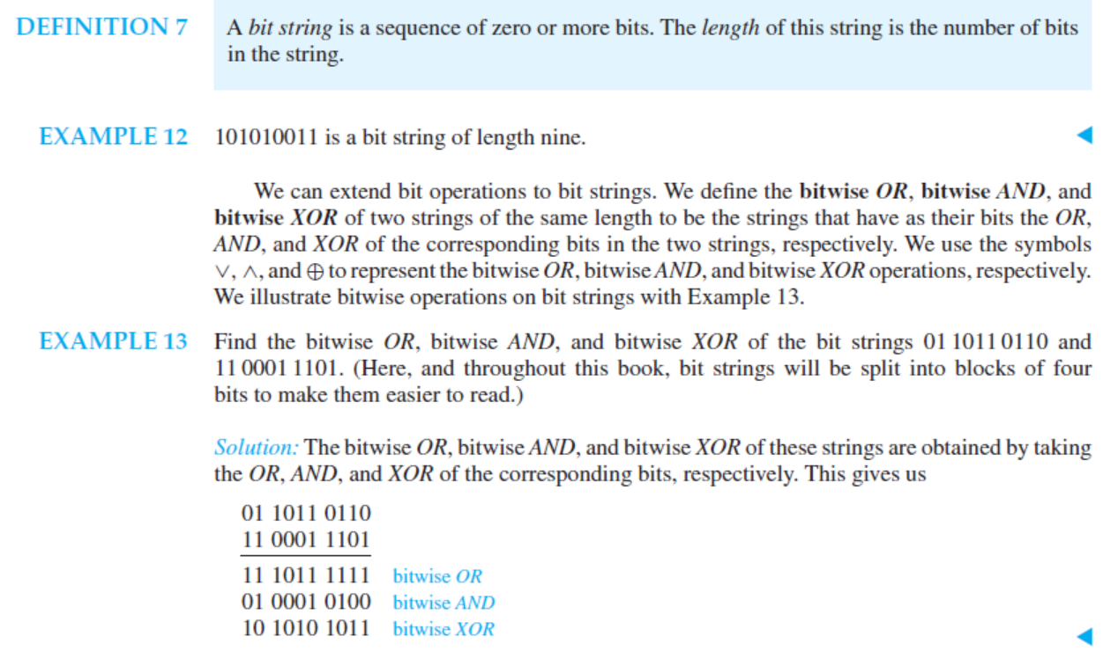
Bit string and bit operation

Slide 50
Practice @ Home
Relevant Odd-numbered Exercises (Answers to the odd-numbered exercises are given at the end of your book)
Supplementary Materials on Conditional Statements (will be uploaded soon!)

